Slide 1
CAP442 Web Technology
Unit III
Session 5
II Year M.C.A

Slide 2
Contents
Introduction to PHP
Expressions and Control flow
PHP functions and objects
Arrays
Form handling
Cookies, Sessions and Authentication
Introduction to MySQL
Accessing MySQL using PHP

Slide 3
Arrays
Arrays are an example of what has made PHP so popular
They provide numerous ways to access data while remaining amazingly fast
Basic Access
In PHP arrays are referenced by numeric indexes and also by alphanumeric identifiers.
Built-in functions available to sort, add or remove sections, and walk through them to handle each item through a special kind of loop.
By placing one or more arrays inside another, multi-dimensional arrays can be created.

Slide 4
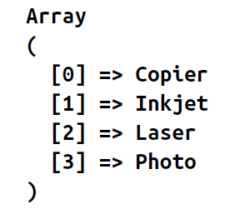
Numerically Indexed Arrays
Simple way to create arrays in PHP is to use “[ ]” after the variable name.
<?php
$paper[0] = "Copier";
$paper[1] = "Inkjet";
$paper[2] = "Laser";
$paper[3] = "Photo";
print_r($paper);
?>

Slide 5
For initialising each element in the array, index variable is not mandatory.
PHP internal counter variable will be automatically increased to new location and values will be stored
<?php
$paper[] = "Copier";
$paper[] = "Inkjet";
$paper[] = "Laser";
$paper[] = "Photo";
print_r($paper);
?>

Slide 6
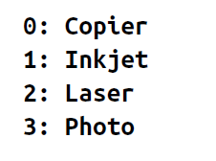
Adding items to an array and retrieving them
<?php
$paper[] = "Copier";
$paper[] = "Inkjet";
$paper[] = "Laser";
$paper[] = "Photo";
for ($j = 0 ; $j < 4 ; ++$j)
echo "$j: $paper[$j]<br>";
?>

Slide 7
Associative Arrays
Keeping track of array elements by index requires extra work in terms of remembering which number refers to which product.
It can also make code hard for other programmers to follow.
This is where associative arrays come into their own.
Using them, the items in an array can be referenced by name rather than by number.
In place of a number, each item now has a unique name that can be used to reference it elsewhere

Slide 8
<?php
$paper['copier'] = "Copier & Multipurpose";
$paper['inkjet'] = "Inkjet Printer";
$paper['laser'] = "Laser Printer";
$paper['photo'] = "Photographic Paper";
echo $paper['laser'];
?>
The names (copier, inkjet, and so on) are called indexes or keys, and the items assigned to them (such as Laser Printer) are called values.

Slide 9
Assignment Using the array Keyword
A more compact and faster array assignment method uses the array keyword.
<?php
$p1 = array("Copier", "Inkjet", "Laser", "Photo");
echo "p1 element: " . $p1[2] . "<br>";
$p2 = array('copier' => "Copier & Multipurpose",
'inkjet' => "Inkjet Printer",
'laser' => "Laser Printer",
'photo' => "Photographic Paper");
echo "p2 element: " . $p2['inkjet'] . "<br>";
?>

Slide 10
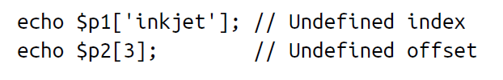
$p1 and $p2 both are different types of array
If we try to access the array elements with incorrect index values, it will cause an Undefined index or Undefined offset error

Slide 11
The foreach...as Loop
Using this loop, all the items in an array, one at a time can be accessed and processed
The process starts with the first item and ends with the last one
So, no need to know how many items there are in an array.
<?php
$paper = array("Copier", "Inkjet", "Laser", "Photo");
$j = 0;
foreach($paper as $item) {
echo "$j: $item<br>";
++$j;
}
?>

Slide 12
When PHP encounters a foreach statement, it takes the first item of the array and places it in the variable following the as keyword; and each time control flow returns to the foreach, the next array element is placed in the as keyword.
In this case, the variable $item is set to each of the four values in turn in the array $paper.
Once all values have been used, execution of the loop ends.

Slide 13
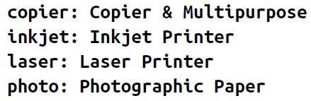
<?php
$paper = array('copier' => "Copier & Multipurpose",
'inkjet' => "Inkjet Printer",
'laser' => "Laser Printer",
'photo' => "Photographic Paper");
foreach($paper as $item => $description)
echo "$item: $description<br>";
?>
Associative arrays do not require numeric indexes
Each item of the array $paper is fed into the key/value pair of variables $item and $description, from which they are printed out.

Slide 14
As list function an alternative syntax to foreach...as, you can use the list function in conjunction with the each function
<?php
$paper = array('copier' => "Copier & Multipurpose",
'inkjet' => "Inkjet Printer",
'laser' => "Laser Printer",
'photo' => "Photographic Paper");
while (list($item, $description) = each($paper))
echo "$item: $description<br>";
?>

Slide 15
In this example, a while loop is set up and will continue looping until each returns a value of FALSE.
The each function acts like foreach: it returns an array containing a key/value pair from the array $paper and then moves its built-in pointer to the next pair in that array.
When there are no more pairs to return, each returns FALSE.
The list function takes an array as its argument (in this case, the key/value pair returned by the function each) and then assigns the values of the array to the variables listed within parentheses.

Slide 16
Multidimensional Arrays
A multidimensional array is an array containing one or more arrays.
PHP supports multidimensional arrays that are two, three, four, five, or more levels deep.
However, arrays more than three levels deep are hard to manage

Slide 17
Two-dimensional Arrays
A two-dimensional array is an array of arrays (a three-dimensional array is an array of arrays of arrays).
First, take a look at the following table:
Name Stock Sold
Volvo 22 18
BMW 15 13
Saab 5 2
Land Rover 17 15

Slide 18
We can store the data from the table above in a two-dimensional array, like this:
$cars = array (
array("Volvo",22,18),
array("BMW",15,13),
array("Saab",5,2),
array("Land Rover",17,15)
);
Now the two-dimensional $cars array contains four arrays, and it has two indices: row and column.

Slide 19
To get access to the elements of the $cars array we must point to the two indices (row and column):
Example
<?php
echo $cars[0][0].": In stock: ".$cars[0][1].", sold: ".$cars[0][2].".<br>";
echo $cars[1][0].": In stock: ".$cars[1][1].", sold: ".$cars[1][2].".<br>";
echo $cars[2][0].": In stock: ".$cars[2][1].", sold: ".$cars[2][2].".<br>";
echo $cars[3][0].": In stock: ".$cars[3][1].", sold: ".$cars[3][2].".<br>";
?>

Slide 20
We can also put a for loop inside another for loop to get the elements of the $cars array (we still have to point to the two indices):
Example
<?php
for ($row = 0; $row < 4; $row++) {
echo "<p><b>Row number $row</b></p>";
echo "<ul>";
for ($col = 0; $col < 3; $col++) {
echo "<li>".$cars[$row][$col]."</li>";
}
echo "</ul>";
}
?>

Slide 21
Using Array Functions
PHP comes with numerous functions for handling arrays.
However, some of these functions are so fundamental that it’s worth taking the time to look at them here.
is_array
Used to check whether a variable is an array
echo (is_array($fred)) ? "Is an array" : "Is not an array";

Slide 22
count
To count all the elements in the top level of an array
echo count($fred);
To know how many elements there are altogether in a multidimensional array
echo count($fred, 1);
The second parameter is optional and sets the mode to use. It should be either 0 to limit counting to only the top level, or 1 to force recursive counting of all subarray elements too.

Slide 23
Sort
sort($fred);
Unlike some other functions, sort will act directly on the supplied array rather than returning a new array of sorted elements.
It returns TRUE on success and FALSE on error
It supports a few flags
sort($fred, SORT_NUMERIC);
sort($fred, SORT_STRING);
rsort($fred, SORT_NUMERIC);
rsort($fred, SORT_STRING);

Slide 24
shuffle
To re arrange the elements of an array randomly
shuffle($cards);
Like sort, shuffle acts directly on the supplied array and returns TRUE on success or FALSE on error.

Slide 25
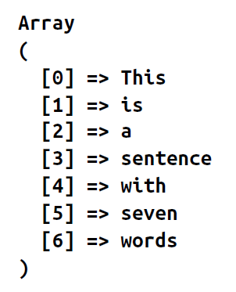
explode
To split input string(separated by special character/string/space etc) into array of elements
<?php
$temp = explode(' ', "This is a sentence with seven words");
print_r($temp);
?>

Slide 26
reset
When the foreach...as construct or the each function walks through an array, it keeps an internal PHP pointer that makes a note of which element of the array it should return next.
If your code ever needs to return to the start of an array, you can issue reset, which also returns the value of that element.
Examples of how to use this function are as follows:
reset($fred); // Throw away return value
$item = reset($fred); // Keep first element of the array in $item

Slide 27
end
As with reset, you can move PHP’s internal array pointer to the final element in an array using the end function, which also returns the value of the element, and can be used as in these examples:
end($fred);
$item = end($fred);

Slide 28
References
https://www.w3schools.com/PHP/default.asp
Robin Nixon, Learning PHP, MySQL, JavaScript, CSS & HTML5, Oreilly, Third Edition, 2014.

